Slide 1
Product Recommendation Approach, Methods & Tools

Slide 2
CSS Corp adopts online user categorization into 5 broad categories for effective online customer engagement strategy
Online Attributes | Searchers | Browsers | Wanderers | Bargainers | First Timers
Characteristics of the group | These are mostly loyalist or fans, and have deep connection to the brand or product | Usually long term players, explorers and keen to seeking information about the products | The type of individuals who need objective points to make decisions, and driven largely on rich visuals | The individuals who are looking for opportunities or triggered by sale, promotion, offers or coupons | The new entrants who may be first timers ti the brand site, and usually need help, and influenced by navigation, content
Purchase Probability | High | Low | Moderate | Moderate | Low
Influencing Attributes | Search Ranking Product updates Reviews Ratings | Ease to navigate Response time Social Platforms Ratings Reviews Search Ranking | Rich media Ease to navigate Cross-sell Up-sell Product comparison | Email Marketing Social Marketing Freebies Discount Promotions | Response time Visual Content Social Integration Ease to Navigate Help & Support – Payment, Product
Engagement Strategy | Connected | Like to personalization | Like to rate the product | Seeks “On Sale” category | Website user experience
What to focus within the site | Content | Guide Personalization | Engagement | Pricing | Experience

Slide 3
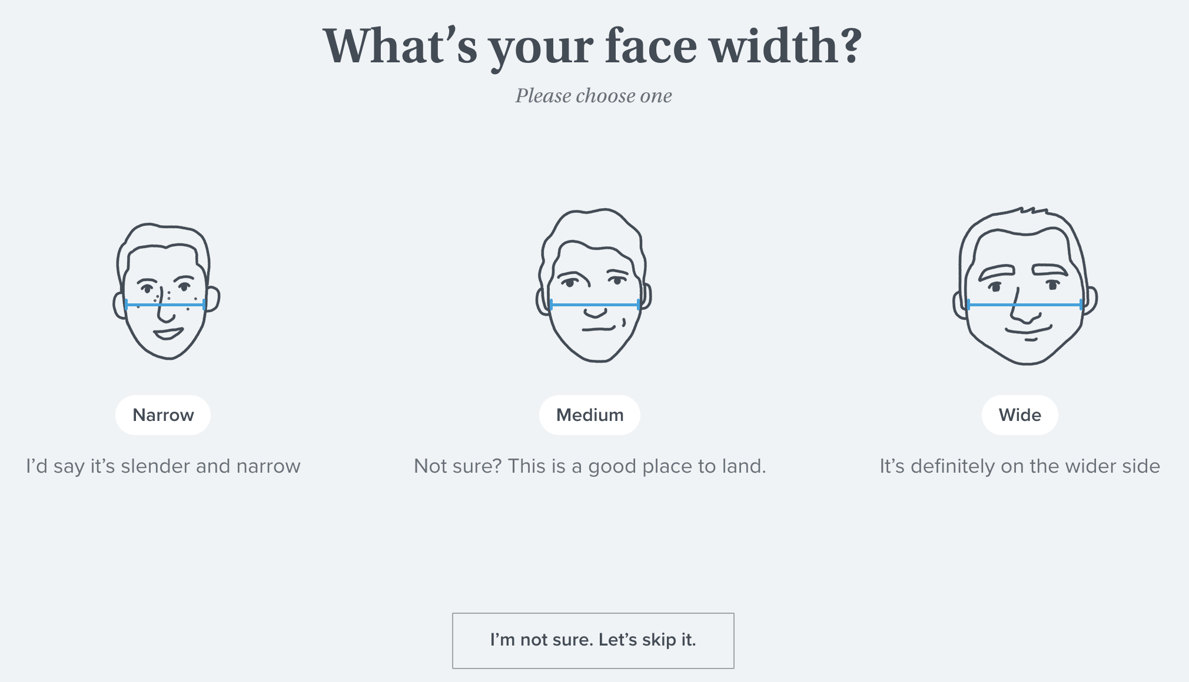
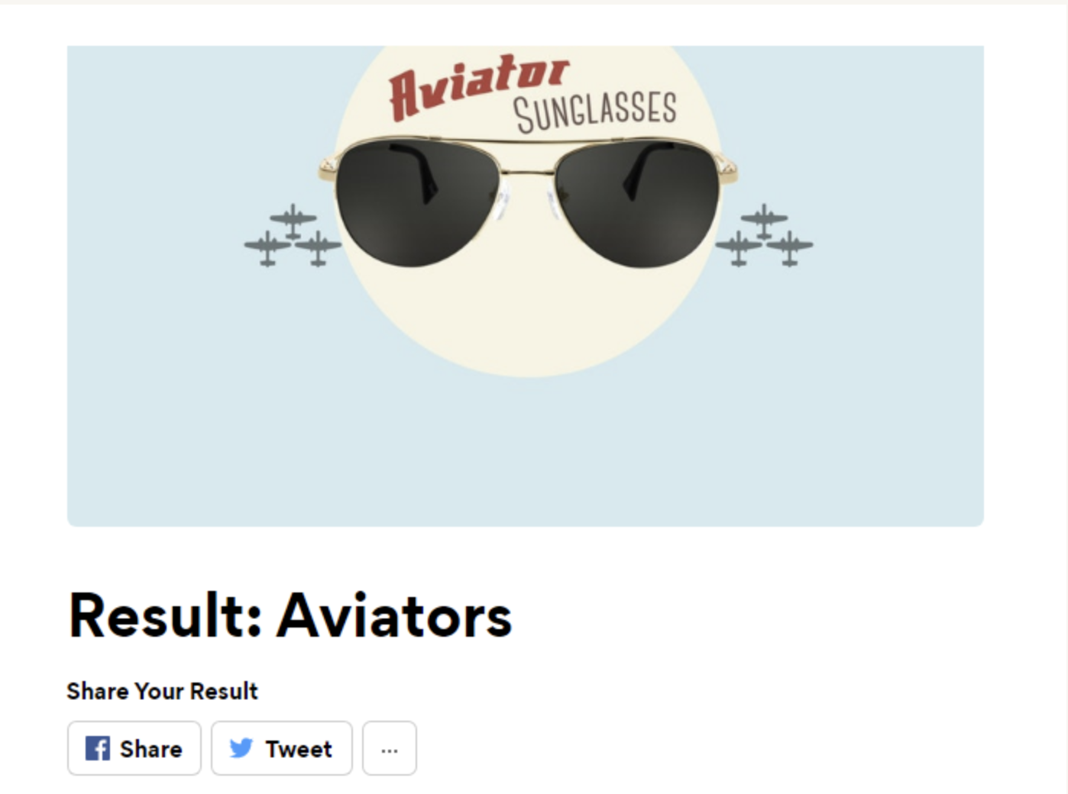
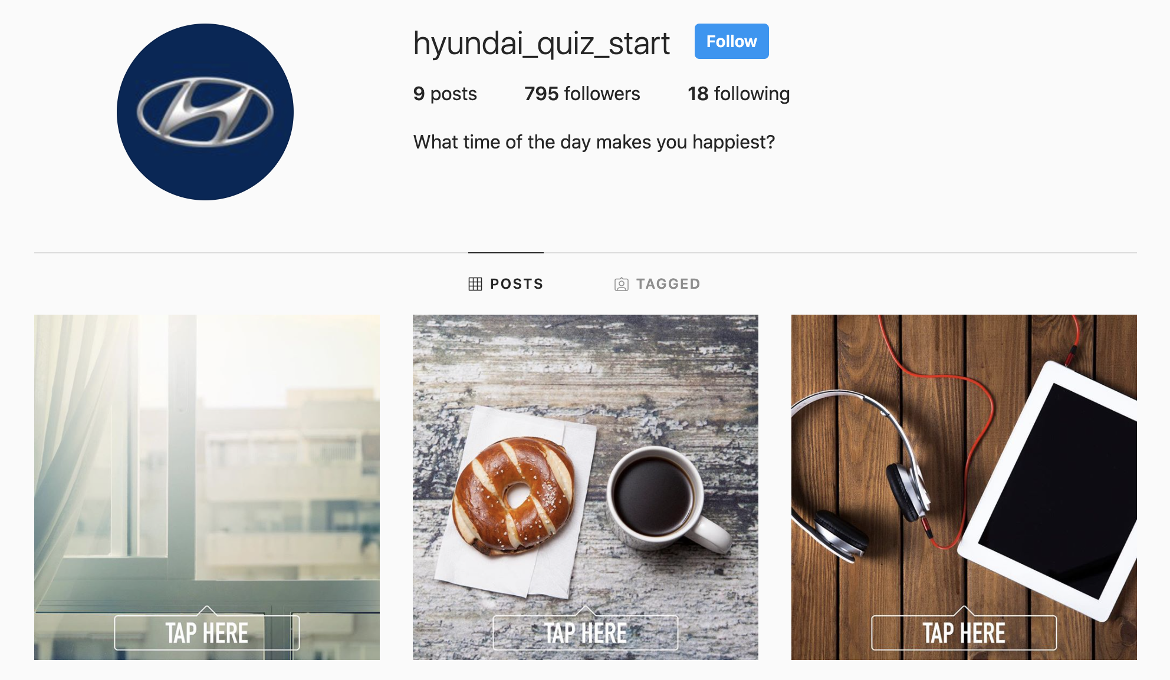
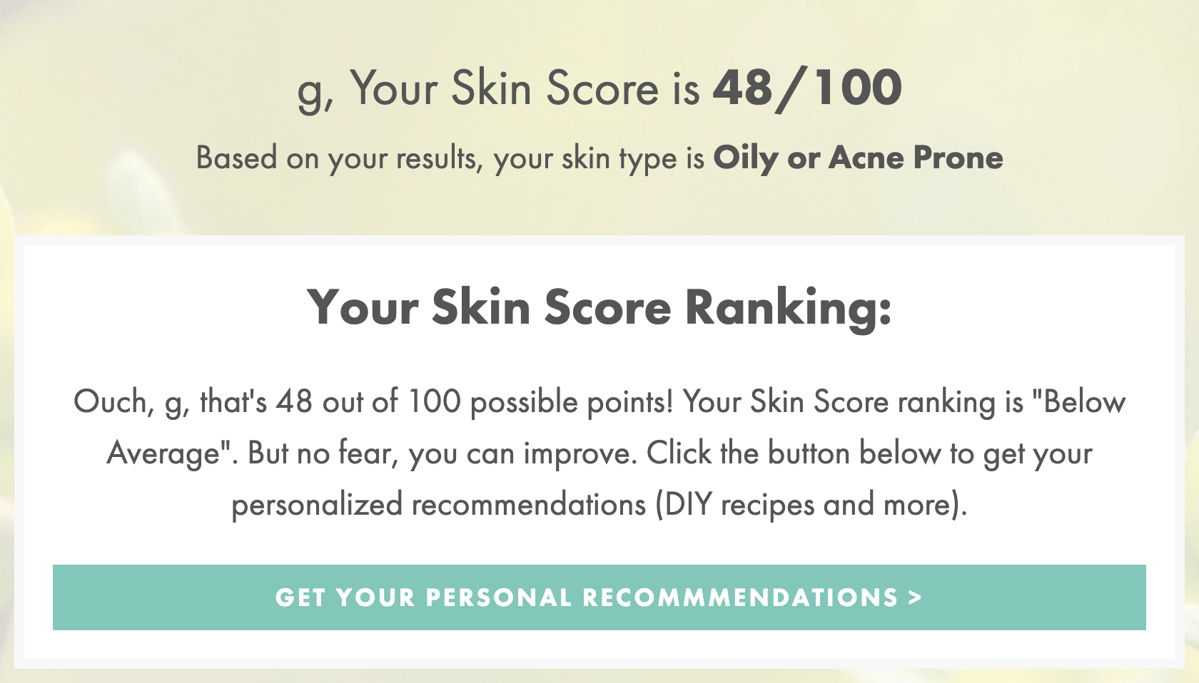
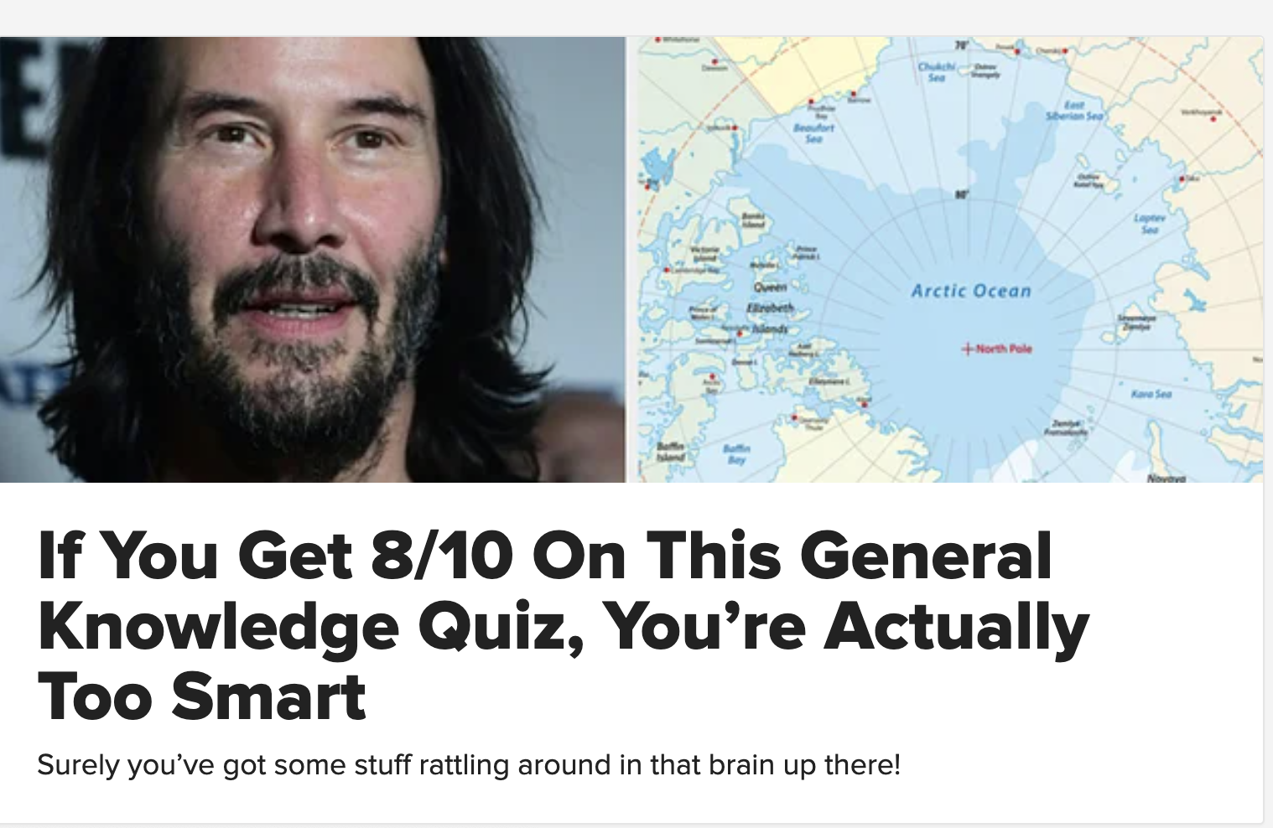
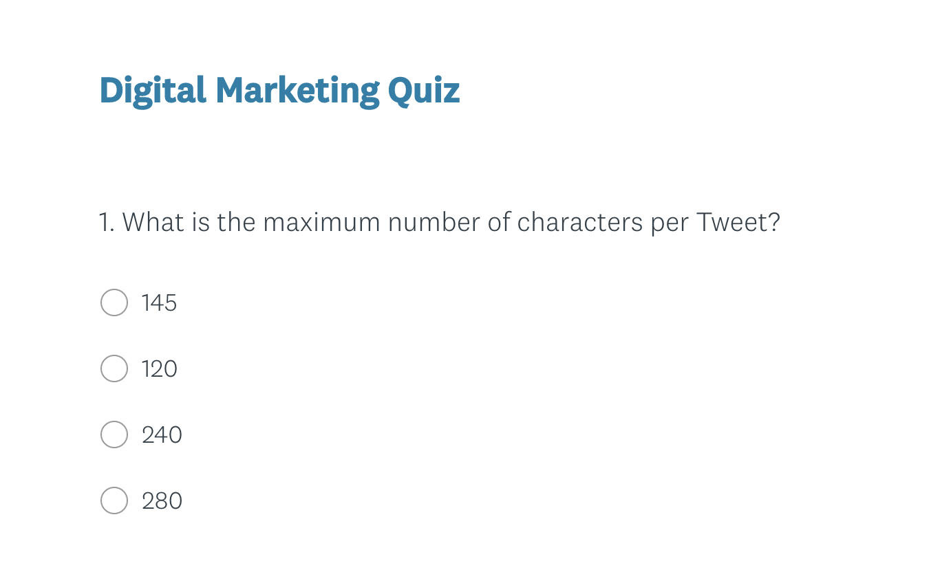
What is the right ‘Type of Quiz’ to engage in product selection?
Inner & Outward
Lifestyle
Social Route
Design interactive approach based on individual body design, and help them select the right product with external factors
A set of questions designed using the themes and lifestyle preferences of the individuals or choices they opt
Leverage Social Channels (Instagram, Facebook, LinkedIn) for hosting product selection quiz
Waby Parker | Skinsei
Zenni Opticals | Axe
Hyundai
Score Based
Personality
Knowledge
Questions are crafted to understand one’s body or needs, and thereby using a score, arrive at the right product
A set of questions designed towards self-awareness, understanding and learn about themselves - Psychological
Designed primarily to challenge the users in a specific topic or area, and thereby lead them to a specific need
Ann Marie
Buzzfeed
BrightEdge

Slide 4




Product recommendation methodology & techniques
User - Product
User - User
Product - Product
User Centric
Product Centric
Quiz Based
Type
Based on availability of the information related to products, users and past order details.
Identifying similar “interactions profile” and relies on the depth of available historical data and user interactions
Identifying “products with similar features” and relies on the depth of available historical product purchases
Based on availability of the information of products that the concerned user has interacted with in past
Designed using historic data involving product attributes, and associated internal and external features
Gather functional/ preference knowledge of concerned Users by making them to take quiz
Methodology
Clustering Technique
Past interactions
Model based
Similar Users data
Past interactions
Scoring or Ranking
Product purchase history
Cluster purchases
User search and purchase history
Feature matching
Product purchase history
Feature matching
Label filtering
Scoring and Ranking
Techniques
Filter
Collaborative Filtering
Collaborative Filtering
Collaborative Filtering
Content based Filtering
Content based Filtering
Knowledge based
Content based Filtering
Demographic
Content based Filtering
Demographic
Utility based
Utility based
Collaborative: Identify similar users and recommend based on their purchases behavior (similarity) | Content Based: Generating recommendation based on users' past purchases using keywords mapped to the items ( | Demographic-based: Region specific user to user correlations are developed | Utility-based : Computation of utility of each product for the user | Knowledge-based : Gathering knowledge of user needs and match it with the products

Slide 5
Illustrative recommendation engine using No Model and Prediction model
Quiz Based Recommendations
Food | Style | Type | Veggie? | Taste
Veg Biryani | Indian | Main Course | Veg | Non-Spicy
Chicken Biryani | Indian | Main Course | Non-veg | Spicy
Sambar rice | Indian | Main Course | Veg | Non-Spicy
Lemon rice | Indian | Main Course | Veg | Non-Spicy
Idly | Indian | Main Course | Veg | Non-Spicy
Dosa | Indian | Main Course | Veg | Non-Spicy
Curd rice | Indian | Main Course | Veg | Non-Spicy
Roti, Nan | Indian | Main Course | Veg | Non-Spicy
Fish curry | Indian | Main Course | Non-veg | Spicy
Mutton Curry | Indian | Main Course | Non-veg | Spicy
Veg curry | Indian | Main Course | Veg | Non-Spicy
Bhindi curry | Indian | Main Course | Veg | Non-Spicy
Veg Pizza | Western | Main Course | Veg | Non-Spicy
Chicken Pizza | Western | Main Course | Non-veg | Spicy
Veg Burger | Western | Main Course | Veg | Non-Spicy
Egg Burger | Western | Main Course | Non-veg | Non-Spicy
Chicken Burger | Western | Main Course | Non-veg | Spicy
French Fries | Western | Starter | Veg | Non-Spicy
Samosa | Indian | Starter | Veg | Spicy
Masala Pappad | Indian | Starter | Veg | Spicy
Chicken 65 | Indian | Starter | Non-veg | Non-Spicy
Crispy corn | Indian | Starter | Veg | Non-Spicy
Veg Salads | Indian | Salads | Veg | Non-Spicy
Non-Veg Salads | Indian | Salads | Non-veg | Spicy
Ice cream | Indian | Desserts | Veg | Sweet
Gulab Jamun | Indian | Desserts | Veg | Sweet
Falooda | Indian | Desserts | Veg | Sweet
Fruit juice | India | Juices | Veg | Salt+Sweet
Lassi | Indian | Juices | Veg | Salt+Sweet
Coke | Western | Beverages | Veg | Sweet
Coffee | Indian | Beverages | Veg | Brewie
Which Food Style?
Indian
Western
What you want to eat?
Starter
Main Course
Non-veg or Veg?
Non-veg
Veg
Treat your taste buds with?
Spicy
Non-spicy
Desserts, Juices
Salads
Food Recommended: Chicken Pizza | Chicken Burger
Similarity model
Popularity model
Prediction model
TF-IDF
Conjunction orders
Clustering Models
Similarity Index Algorithm
Top related purchases
User purchase history
ML models
Food Recommended: Chicken Pizza
Fish Curry
Chicken Burger
Egg Burger
Chicken Biryani
Food Recommended: Chicken Pizza
Chicken Burger
French fries
Samosa
Salads
Food Recommended: Chicken Pizza
Chicken Burger
Ice cream
Fruit Juice
Falooda

Slide 6
Illustrative recommendation engine using Market Basket Analysis Using Association Rule Mining (Popularity based )
Order History
Association Rule Mining a rule-based ML method for discovering interesting relations between variables in large databases.
Commonly used ML algorithms:
Apriori algorithm
Frequent-Pattern growth algorithm
Date | Order ID | Item list | Item count | Price | Total Price
19-Jun-17 | 1 | PREP + PRIME SKIN | 2 | 1890 | 3780
19-Jun-17 | 1 | PRO LONGWEAR CONCEALER | 2 | 1680 | 3360
19-Jun-17 | 1 | POWDER KISS LIPSTICK | 1 | 1540 | 1540
19-Jun-17 | 1 | MINERALIZE BLUSH | 1 | 1400 | 1400
11-Apr-17 | 2 | MINERALIZE SKINFINISH NATURAL | 1 | 1470 | 1470
11-Apr-17 | 2 | CREMESHEEN LIPSTICK | 2 | 1470 | 2940
11-Apr-17 | 2 | PRO LONGWEAR PAINT POT | 2 | 1470 | 2940
11-Apr-17 | 2 | POWDER BLUSH | 2 | 1470 | 2940
22-May-19 | 3 | EXTRA DIMENSION SKINFINISH | 2 | 1610 | 3220
2-Apr-20 | 4 | STUDIO FIX FLUID SPF 15 | 3 | 1960 | 5880
2-Apr-20 | 4 | MINERALIZE SKINFINISH NATURAL | 1 | 1470 | 1470
Association Rule based ML model
Periodically run and save the trained model
Quiz Based Recommendation:
POWDER KISS LIPSTICK
Popularity based Recommendation:
LOVE ME LIPSTICK (0.42)
SATIN LIPSTICK (0.41)
PREP + PRIME SKIN ( 0.39)
EXTENDED PLAY PERM ME UP LASH MASCARA (0.36)
PRO LONGWEAR CONCEALER (0.36)
14-Oct-17 | 999 | LIPGLASS | 2 | 1820 | 3640
14-Oct-17 | 999 | EXTENDED PLAY PERM ME UP LASH MASCARA | 3 | 1540 | 4620
23-Mar-18 | 1000 | RETRO MATTE LIPSTICK | 3 | 2170 | 6510
23-Mar-18 | 1000 | MINERALIZE BLUSH | 2 | 1400 | 2800
23-Mar-18 | 1000 | STROBE CREAM | 1 | 1960 | 1960

Slide 7
Illustrative recommendation engine using TF-IDF & cosine similarity (Similarity based )
Order History
Category | Product name | Description | Key claims and benefits | Ingredients
Lipstick | Powder Kiss Liquid Lipcolour | Believe it when you feel it. Powder Kiss now includes a Liquid … | Immediate and 10-hour moisture Long-wearing, 10 h.. | Dimethicone, Tridecyl Trime…
Lipstick | Matte Lipstick | This creamy rich formula features high colour payoff in a no-shine… |  | Dimethicone, Tridecyl Trime…
Lipstick | Powder Kiss Lipstick | Matte, totally reinvented. Delivering a blur of soft-focus colour… | Provides immediate and long-term hydration … | Dimethicone, Tridecyl Trime..
Lipstick | Love Me Lipstick | Love at first swipe! Fall in love with an argan oil-infused formula… | Vivid full-coverage colour payoff in one swipeuse…. | Polybutene, Caprylic/Capric …
Lipstick | Retro Matte Lipstick | This long-wearing formula features an intense colour payoff and.. | Long-wearing, eight hours, Non-feathering, Fade-proof | Isoeicosane, Kaolin, Ceresin…
Lip-Gloss | Lipglass | A unique lip gloss available in a wide variety of colours that can… | Provides a glass-like shine, Conditions lips, Smoothes lips | Hydrogenated Polyisobutene…
Lip-Gloss | Powerglass Plumping | Ka-pout! Get into a plump that lasts. This high-shine lip gloss.. | Immediate and long-term hydration, Softens and… | Ricinus Communis, Seed Oil…
Foundation | Studio Tech | A tri-system blend of water, emollients and powder glides on… | Long-wearing, Blends perfectly, Refines skin… | Water\Aqua\Eau, Cyclopent..
Foundation | Pro Palette Full Coverage | NW50, NW45, NW40, NW30, NW25, NW20, NC55, NC45, NC3 | Long-wearing, 12 hours, Crease-proof, Water-resistant | Octyldodecanol, Dipentaeryt..
Powder | Studio Fix Powder Plus | A one-step powder and foundation that gives skin a smooth and … | Immediately reduces appearance of pores, Controls … | Talc, Silica, Isostearyl Palmitate.
Quiz Based Recommendation:
POWDER KISS LIPSTICK
Popularity based Recommendation:
PATENT PAINT LIP LACQUER (0.54)
LIPSTICK MATTE LIPSTICK (0.54)
LIP-GLOSS PATENT PAINT LIP LACQUER (0.54)
LIPSTICK RETRO MATTE LIQUID LIPCOLO (0.53)
LIPSTICK SATIN LIPSTICK (0.52)
TF-IDF & cosine similarity algorithm
Periodically run and save the trained model

Slide 8
A representative product selection quiz template: Standard and custom Elements
8
<<Quiz Header>>
1
<<Title – Label - Question>>
2
<< Progress Bar >>
3
<<Exit Label>>
4
<<Skip Label>>
6a
Option 1
6b
Option 2
6c
Option 3
7a
Background Image #1
7b
Background Image #2
7c
Background Image #3
5
<<Restart Label>>
9
<<Quiz Footer>>

Slide 9
CSS Corp interacts with over 200,000 customers on a daily basis through its business, and has built a repository of practices for greater engagement
Representative Best practices, Checklist & Lessons learnt
Focus on short title & labels in the messaging
8-60 rule for titles and labels
Compelling picture or the image with right message
Images to meet the mood that has to be conveyed
Images content has to be dominant, 70% covered and unambiguous
70% taking quiz must complete – measure of simplicity
Adding 1 additional level (or set of questionnaire) is likely to drop by 30% or lower
No mandatory forms
Where is the drop-off questions – Max # of questions to reach the product (5 to 10) linked to 3 minute rule
Share rate computation – social forums
Option Type: Binary Options (Yes-No or True-False) | Multiple Choice (Text vs Visual options)
Personalization the message (You, Your...)
Critical decisions to be positioned in odd number question or option (3, 5, 7)
Use of soft intimidation approach readers (actually, most)
Classic personality traits to describe majority of population:
Openness (Closed, routine vs imaginative, transparent)
Conscientiousness (Spontaneous vs careful, disciplined)
Extraversion (Reserved vs Social, fun-loving)
Agreeableness (Uncooperating vs Trustful, helping, adjustable)
Neuroticism (pessimistic, anxious vs calm, confident)

Slide 10
CSS Corp defined Product Recommendation Engine Process flow
Conceptualization
Strategy & Assessment
Design | Configuration | Build | Validation
Why Quiz?
Choose medium
Define purpose, objectives, end-goal
Define metrics, KPI
Baseline as-is
Plan the intermediate goals, milestones (where to reach and how fast?)
Web SPA | Bot Based | Social Route | 3rd party hosting
Recommendation Technique | Filtering Method | Model vs No Model
Validation | Sampled User Base
Launch Quiz
Type of Quiz
Finalization
User base characteristics
Design Elements
User information| Behavior pattern | Engagement levels | Traffic | Interaction methods
Brand-Product Attributes
Business Rules checks | Min-Max Questions limits | Abort-Resume checks | Links flows | Navigation checks in and between forms | Caption, Labels checks | Mode of interaction checks
Performance benchmark | Loading speed | Navigation speed | Closure speed | User concurrency | Alternative flow checks | Negative scenarios checks | Defects retest & closure
Brand insights| Product information | Volumes | Sales Trend | Purchase patterns | Similar products | Competition

Slide 11
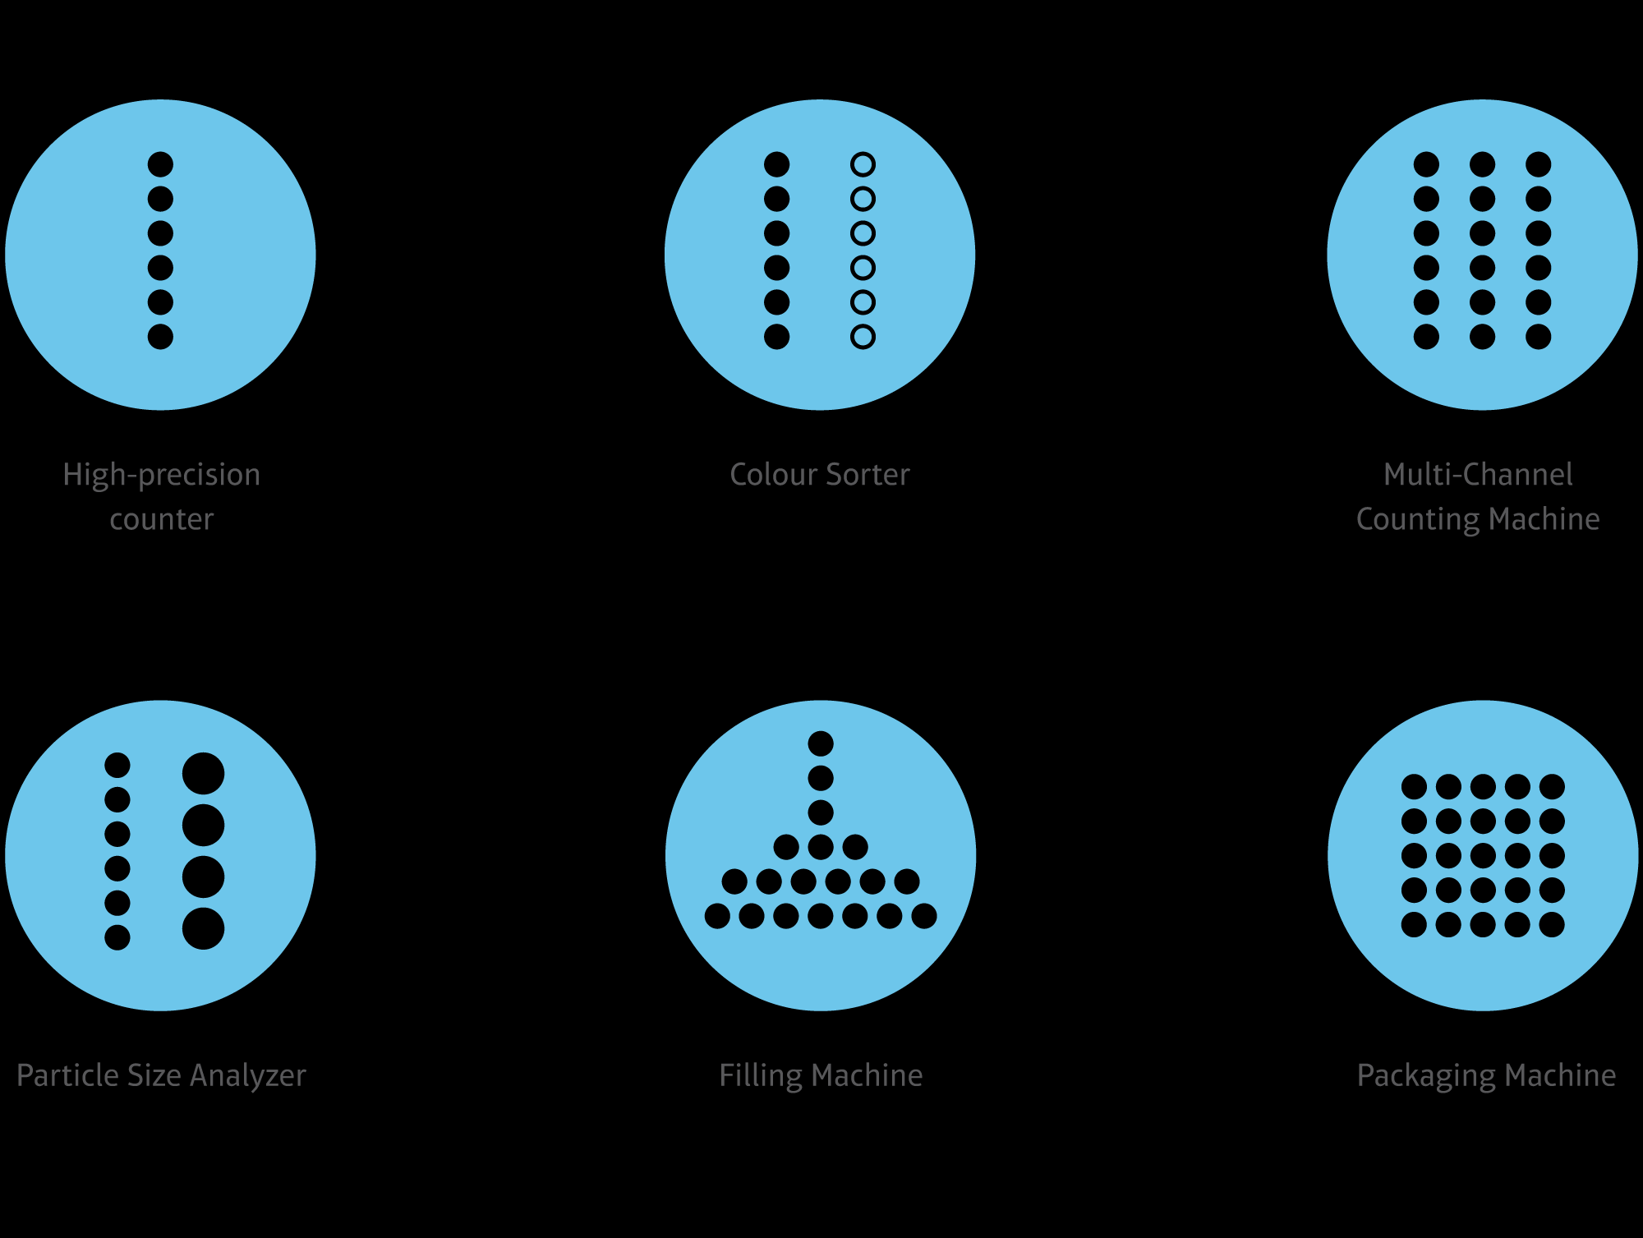



CSS Corp accelerators, tools and solutions for effective product recommendation services
ElemenTAI
TieferAI
InterfazAI
Website – Digital Assurance kit
AI Based visual assessment framework
Element level visual Analysis
SEO+FEO Check
Automated RPA based FEO metrics generation
Site RakenAI
Page RakenAI
ImagifAI
speAIr
Site level Structure Analysis
Page level structural analysis
Color Scheme, Histogram, Contrast
Configurable ADA compliance tool
Product Reviews & Ratings
Analysis of reviews & comments
Rating correlation
Topic Modelling & User Experience Mining
Recommendation Engine
Best Practices
Automated QTree
Feature BuildAIr
Active Insights
Checklist | Standards | Validation points
Scalable quiz builder
Framework to build product-attributes models
Pre & Post analytics & Insights on the brand
Content Testing
nAIl - it
Construct Complexity
Context Complexity
Comprehensivism
Anomalies detection, readable complexity
Word Syllable Analysis & Scores
Flesch Kincaid Reading-Ease score
Dale-Chall score, spache score

Slide 12
THANK YOU

